Slide 1
Welcome to
Mrs Bland’s Nursery
and Infant School

Slide 2
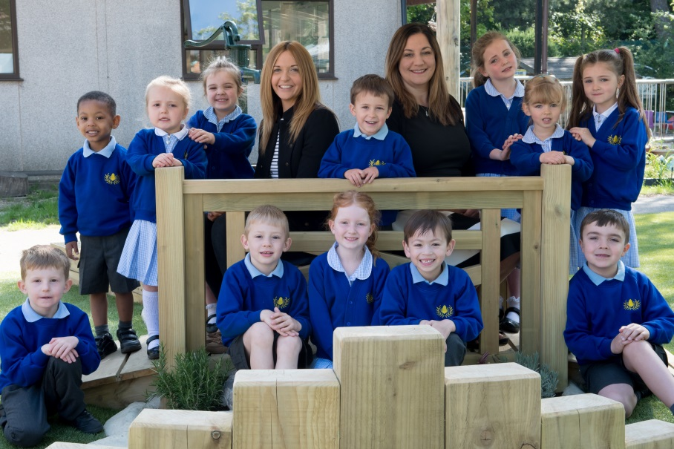
Welcome!
This presentation aims to provide am introduction to Mrs Bland’s and includes initial information which we hope you will find useful.
The school website www.mrsblandsinfants.co.uk is kept up to date and has lots more information about our school.
Headteacher: Mrs Nisbet Deputy Head: Mrs Williams

Slide 3
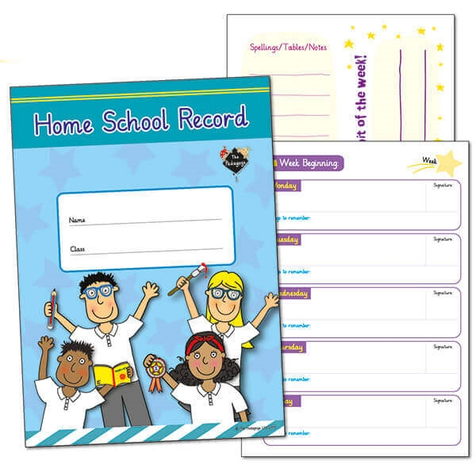
Partnership with Parents
When parents and practitioners work together, the results have a positive impact on children’s development and learning.
Communication between school and parents is key and there are plenty of opportunities for this, such as during the daily drop off and pick up and in the home-school record books etc.
Our Home-School Agreement provides a framework for the development of such a partnership and sets out the role of the school, parents and pupils in this vital partnership.
We operate an Open Door Policy and parent volunteers are always welcome!

Slide 4
Mrs Bland’s School Rules
As a school, we agreed the four following rules:
To try hard in everything we do and persevere
To care for everyone and everything
To use good manners to everyone at all times
To play fair
We refer to our school rules regularly in class and in our whole school assemblies.

Slide 5
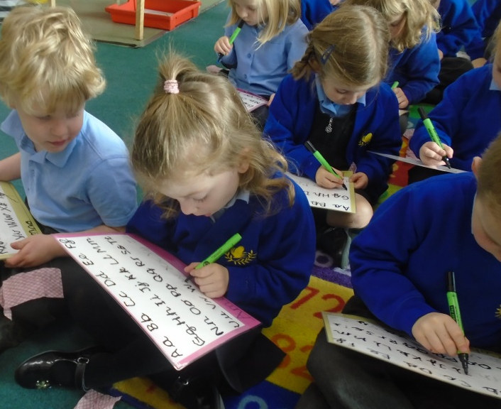
The School Day
8.50 - School doors open
9.00 – Registration
9.10 – Assembly
9.30 - Phonics
10.30 – Session 1
10.45 – Snack (fruit/milk)
11.45 - Lunch
1.00 – Registration
1.05 - Handwriting
1.20 – Session 2
2.30 – Session 3
3.25 - Time to go home

Slide 6
Attendance
By law your child must attend school every day.
If your child is absent from school you must let
the office know the reason why, either by phone or email, by 9.30am.
Only the Headteacher can sanction an absence.

Slide 7
Food and drink
Lunch: For Reception, lunchtime is between 11.45am and 1.00pm. All of the children in school are entitled to a free school meal each day. There will be a selection of different meals available each day for your child to choose from. You can do this with your child at home or they can choose with an adult in class. Please let us know if your child has any dietary restrictions or requirements.
Packed lunches must support our school’s healthy eating policy. Please note that our school is a ‘nut free’ zone which means that all types of nuts are banned.
Drinks: Water is available throughout the day, including lunchtime. We ask that all children bring in a bottle of water to school – remembering that sugary drinks are not allowed. We also provide free milk to all four year olds.

Slide 8
Health
Staff need to be aware of your child’s medical background, in particular any allergies and any medical conditions that are important for us to know.
Children can suddenly become ill and therefore it is really important that we know we can contact you or your named contacts at all times. Please ensure that the school is kept up to date with your contact details.

Slide 9
Uniform
Boys – Winter Boys – Summer
Dark grey trousers Short sleeved pale blue shirt
Pale blue long sleeved shirt Grey shorts
Royal blue school jumper with logo Royal blue school jumper with logo
Blue or grey socks
Black sensible shoes
Girls - Winter Girls - Summer
Navy pinafore or skirt Blue/white checked (gingham) dress
Pale blue long sleeved shirt Royal blue school cardigan with logo
Royal blue school cardigan with logo White socks
White socks or plain grey or navy tights Black sensible shoes
Black sensible shoes Blue hairbands/ribbons
Please ensure that all clothing that your child wears or brings into school is clearly named.

Slide 10
What children need in school
Your child will need to have the following named items in school:
PE Kit – navy shorts, school PE T-shirt, navy tracksuit, plimsolls and trainers
Wellington boots
Book bag
Water bottle
Waterproof coat
Apron

Slide 11
The Early Years Foundation Stage
The Early Years Foundation Stage is shaped around seven areas of learning and development:
The Prime areas of learning:
Personal, Social and Emotional Development
Communication and Language
Physical Development
The Specific areas of learning:
Literacy
Mathematics
Understanding the World
Expressive Arts and Design

Slide 12
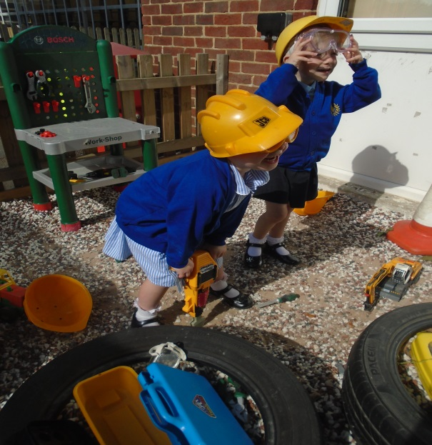
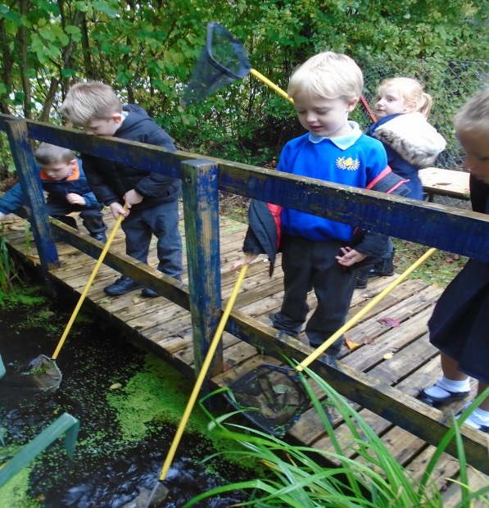
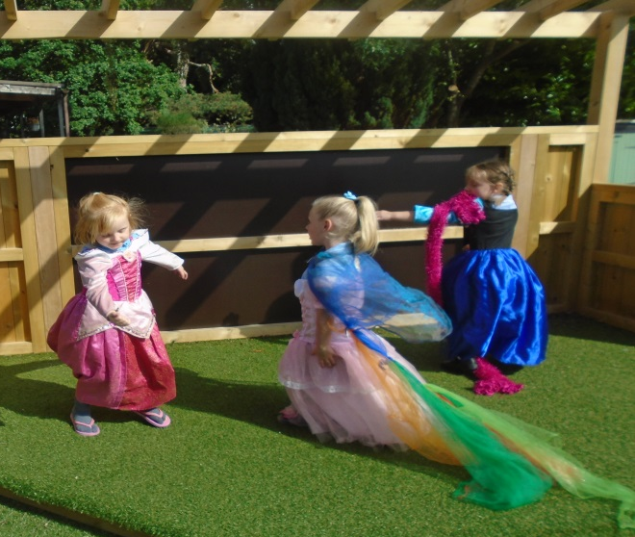
The Prime Areas
The Prime areas are the foundation on which the specific areas are built. They lay down the foundation for all children’s learning, ensuring that children are able to relate to others, communicate effectively and engage with their environment. Without good communication and language skills, social and play skills and good physical development, children will struggle to achieve in the specific areas.

Slide 13
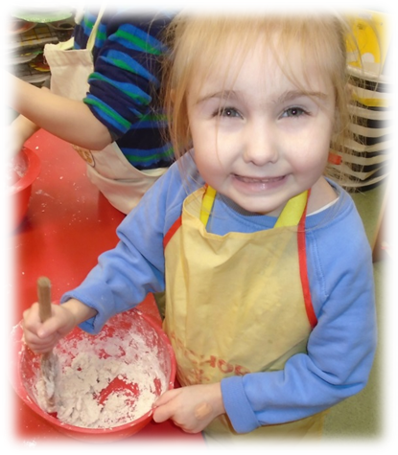
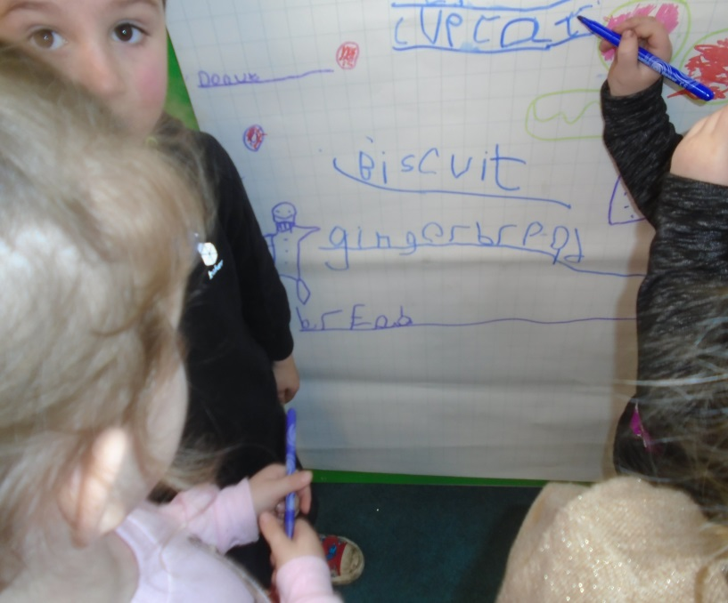
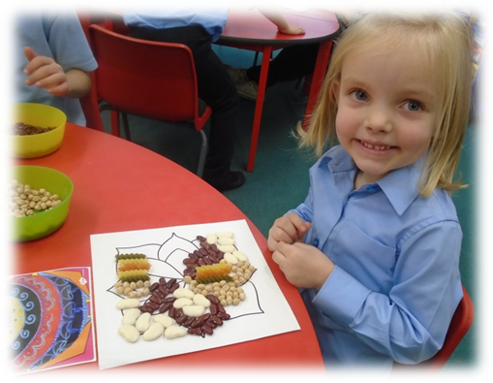
The Specific Areas
The Specific areas are fundamental in a child’s life. The specific areas include essential skills and knowledge for children to
participate successfully in society. They grow out of the prime areas and provide important contexts for learning.

Slide 14
The Learning Environment
The children have daily access to an indoor and outdoor environment that is set up in discrete areas of learning. The areas are carefully planned and provide the children with experiences and opportunities whereby they can independently apply and consolidate their learning.
On the next two slides we have included examples of the children in Reception at Mrs Bland’s pursuing a range of activities in both the indoor and outdoor learning environment. These are just a very small sample…

Slide 15
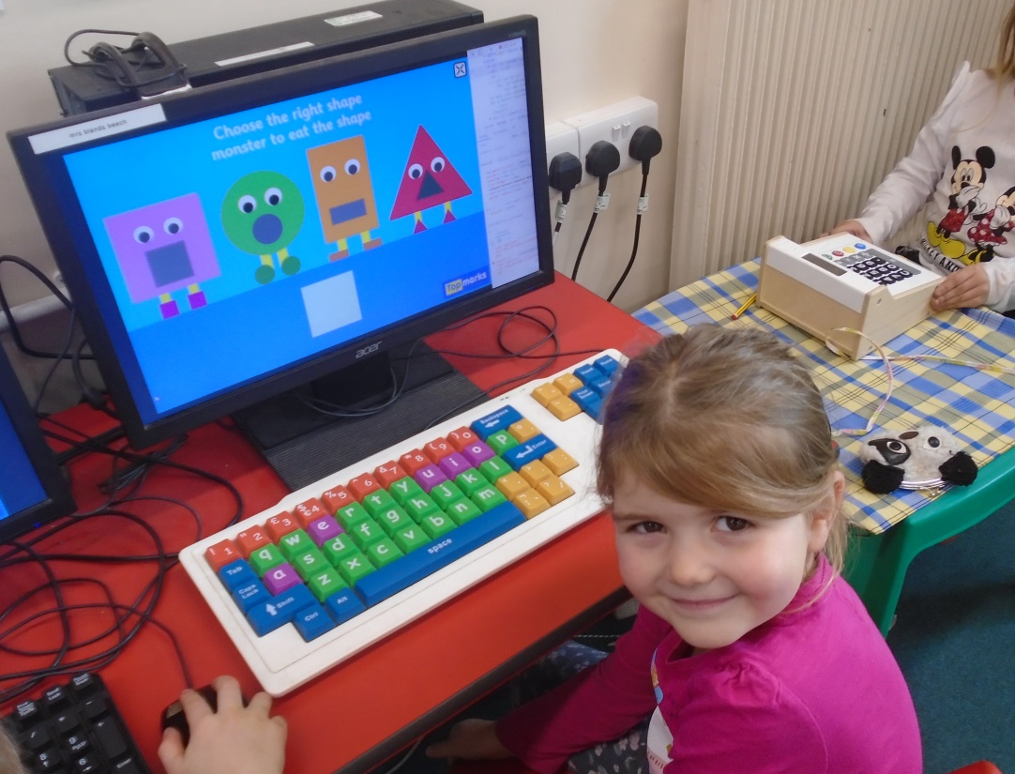
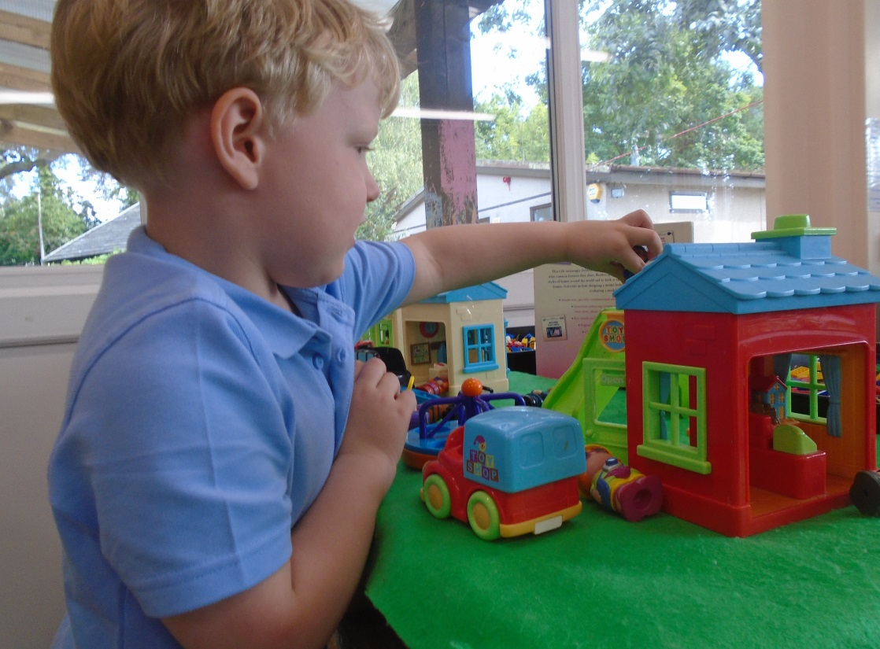
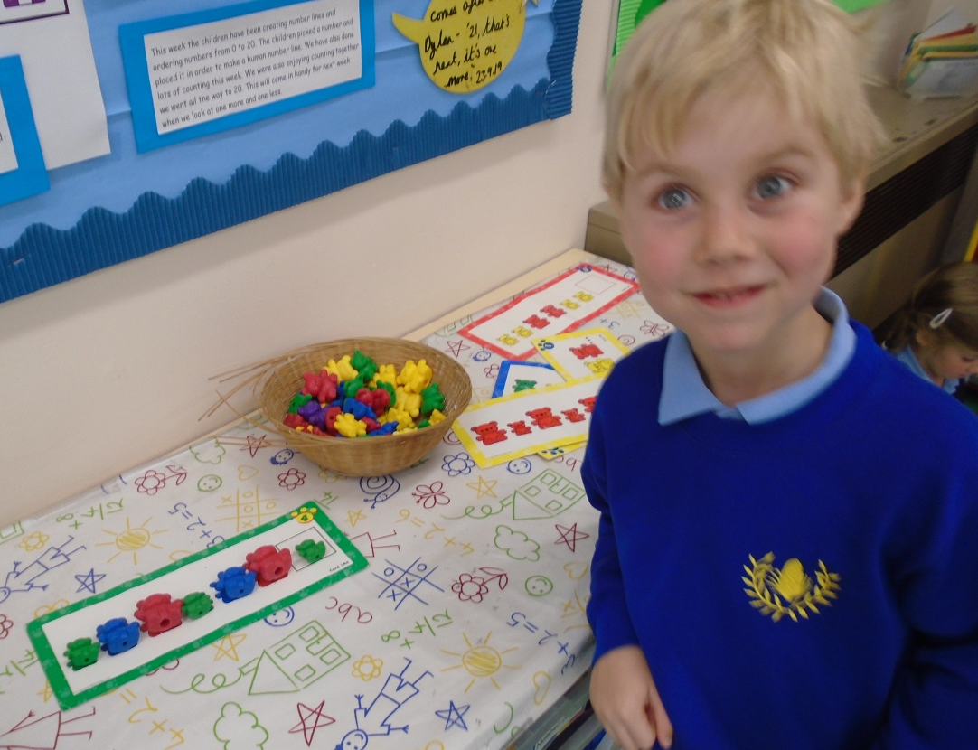
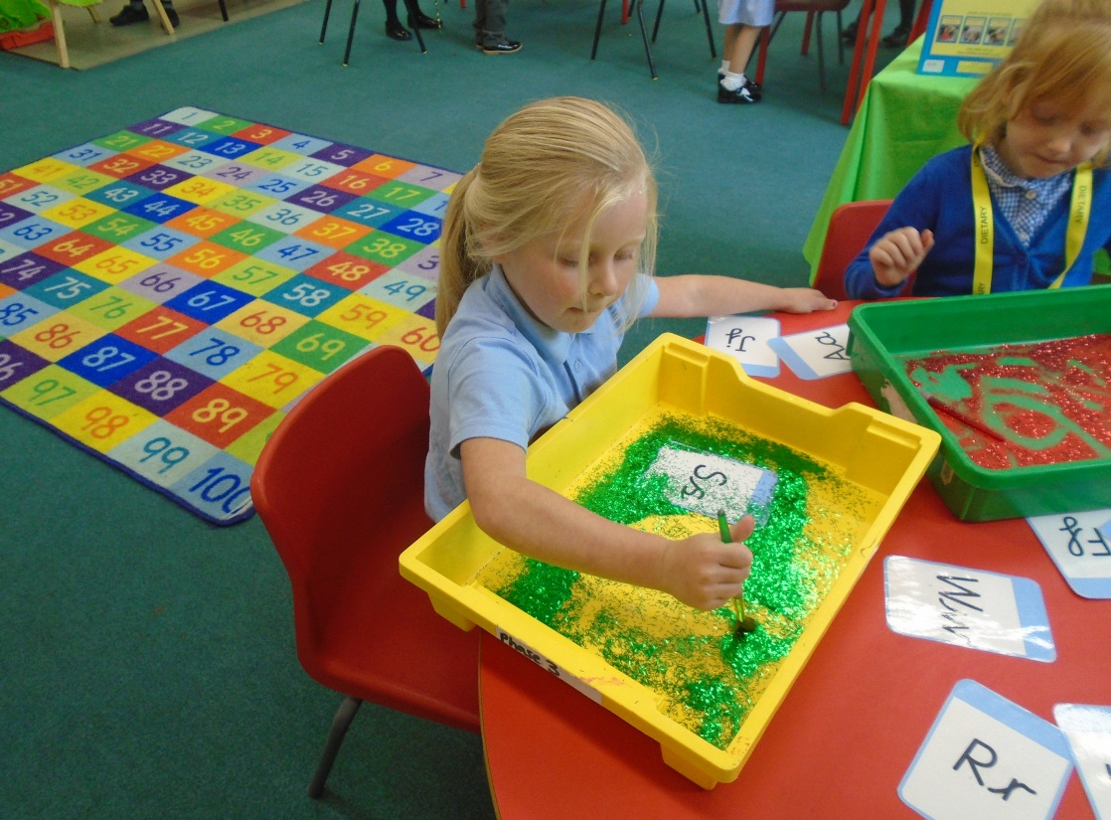

Slide 16
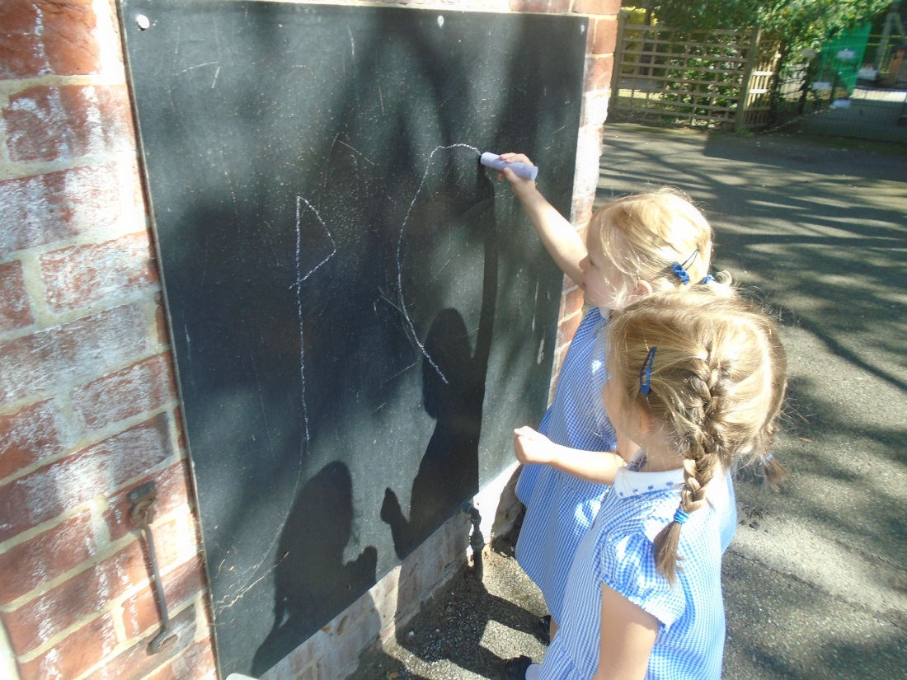
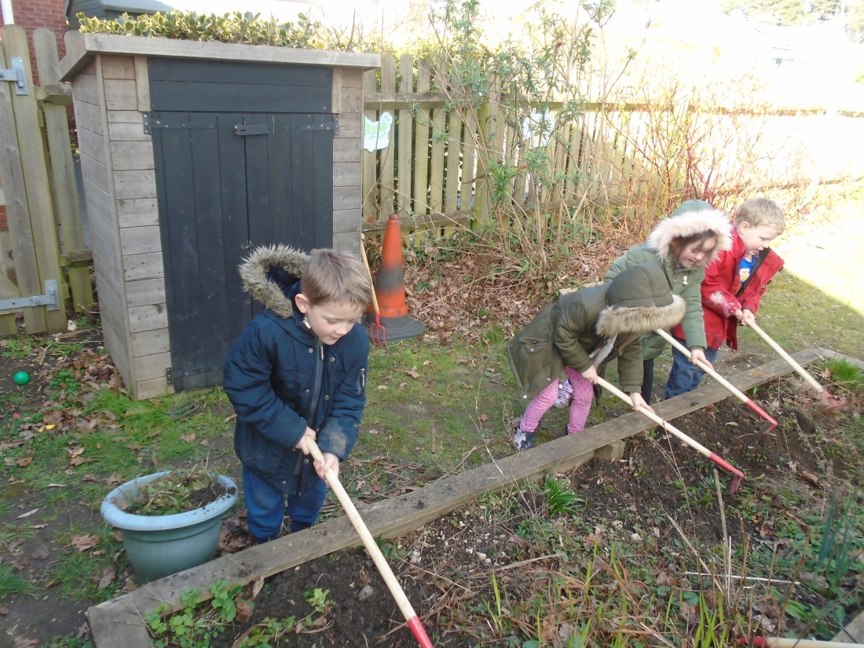
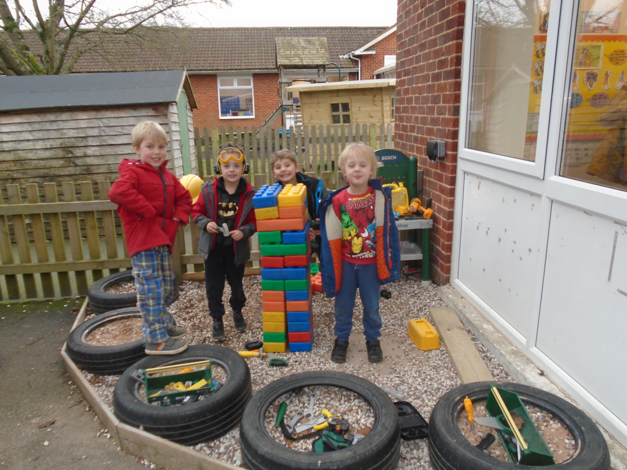

Slide 17
Early Years Foundation Stage
In the EYFS, on-going assessment is an integral part of the learning and development process.
It involves practitioners observing children to understand their level of achievement, interests and learning styles, and to then shape learning experiences for each child reflecting those observations.
The Foundation Stage Profile provides a quantifiable measure that will assess and record a child’s level of achievement as he or she finishes the Reception year.

Slide 18
Learning Journeys
Every child will have their own learning journey which will record and celebrate their experiences during the Foundation Stage. Over time it will tell a story about your child’s learning and achievements, their friendships and the activities he or she enjoys sharing with others. We share these with you on a regular basis and welcome ‘WOW’ moments from home!

Slide 19
Preparing for School
Let your child practise putting on their school clothes, taking them off and folding them neatly in preparation for PE lessons
Support your child in managing their toileting independently
Get your child into the habit of hanging their coat up, putting their toys away, clearing the table, and so on, to prepare them for doing these things at school
Play listening and instruction based games e.g. Simon Says and play simple board, card and ball games that teach the children about taking turns, following rules and losing graciously
Sing number rhymes together and look out for numbers in the environment
Look out for opportunities for the children to see their name

Slide 20
Finally…
If we’re worried about your child we will talk to you
If you’re worried about anything to do with school and your child - come in and talk to us!
If your child has any specific needs, whether emotional, medical or learning difficulties, please do let us know
We’re a partnership!

